Slide 1
Creating a Dashboard in Cognos Analytics

Slide 2
Current Workflow

Slide 3
Current Workflow
I already have a Cube View in TM1
I would like to create a Dashboard

Slide 4
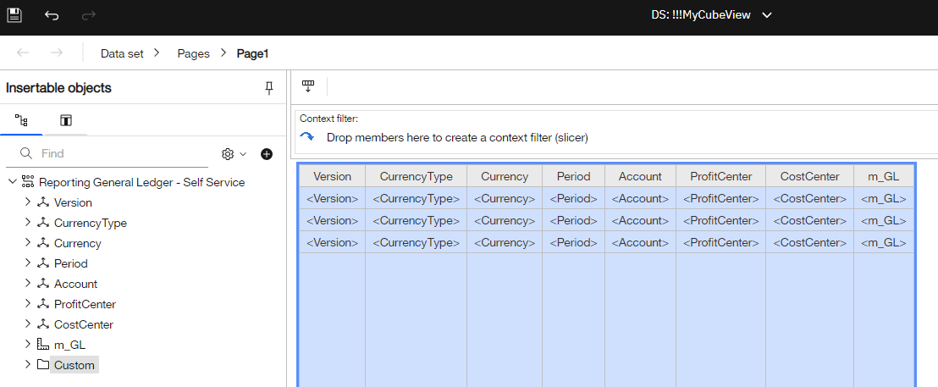
Current Workflow
First, I must create a Data Set from the Cube.
This is a duplicate effort as I've already created my Cube View...

Slide 5
Current Workflow
Next, I create a Data Module in case I need to add additional sources later:

Slide 6
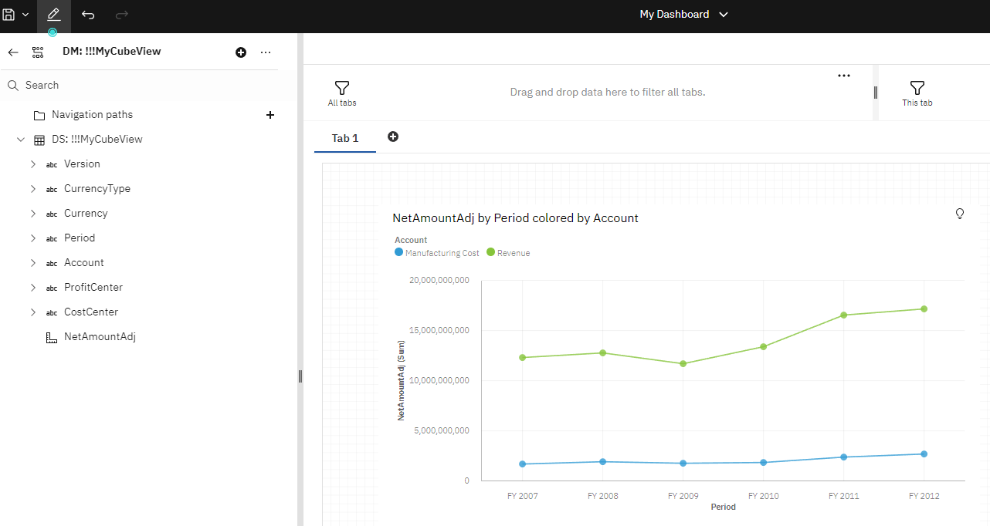
Current Workflow
Then, I create my dashboard:

Slide 7
Desired Workflow

Slide 8
Desired Workflow
I already have a Cube View in TM1
I would like to create a Dashboard

Slide 9
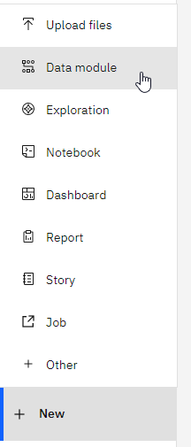
Desired Workflow
First, I create a Data Module:

Slide 10
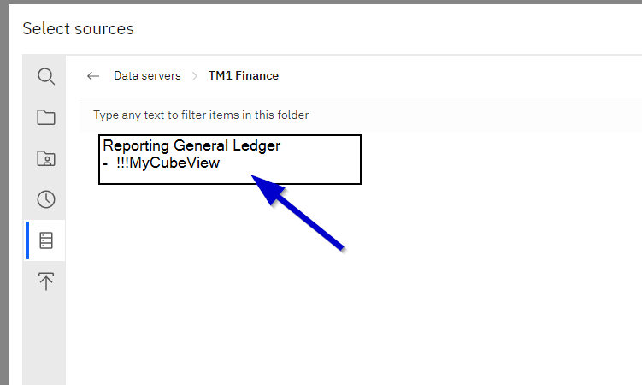
Desired Workflow
I select my Cube View as a source:

Slide 11
Desired Workflow
Cognos Analytics generates an MDX query from my Cube View.
Next, I save my Data Module.
This way, I can add additional sources in the future to join to my TM1 data.

Slide 12
Desired Workflow
Then, I create my dashboard:

Slide 13
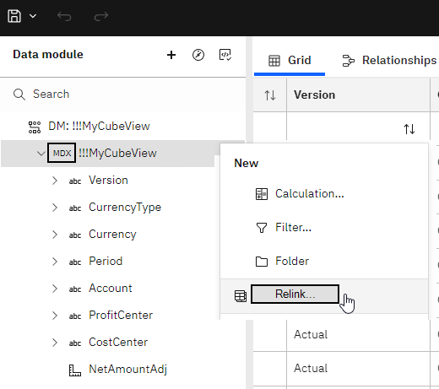
Desired Workflow
If I ever need to update my view (MDX query)...
I relink and select the updated Cube View:

Slide 14
Workflow Comparison
Current Workflow
Must recreate cube view as a data set.
Refresh is required, data is point-in-time.
Data is not secured via TM1, anyone can see the data based on my access...
I may as well use PowerBI!
Desired Workflow
Data automatically converted to tabular.
Dashboard queries TM1 in real-time.
Data is secured by TM1 for each user accessing my dashboard.
Why would I use PowerBI?

